Slide 1




Increase Test Coverage
Code Coverage
Continuous Integration
Reduce Script Runtime
SPVSS Automation Team: spvss-vat@cisco.com

Slide 2
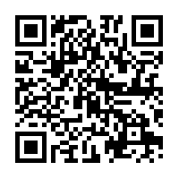
SPVSS Automation Toolkits (VAT):
A Quick and Nimble Automation Engine
Automation
Management
(AIMS)
Automation
Reporting
Automation
Training
(IWE)
(AIMS, ATS,
TRADe, TIMS)
VAT
Automation
Execution
Automation
Development
(AIMS, ATS, Jenkins)
(ITE, ITEAEF, CVS)
100% Automation For Agile!
SPVSS Automation Team: spvss-vat@cisco.com

